Slide 1
ECEG-5193: Algorithm Analysis and Design
Basics of Algorithm Analysis
Big-Oh, Omega and Theta notations

Slide 2
Worst, Average, and Best-case Complexity
Worst-case Complexity
Maximum steps the algorithm takes for any possible input.
Most tractable measure.
Average-case Complexity
Average of the running times of all possible inputs.
Demands a definition of probability of each input, which is usually difficult to provide and to analyze.
Best-case Complexity
Minimum number of steps for any possible input.
Not a useful measure. Why?

Slide 3
Kinds of analyses
Worst-case: (usually)
• T(n) = maximum time of algorithm on any input of size n.
Average-case: (sometimes)
• T(n) = expected time of algorithm over all inputs of size n.
• Need assumption of statistical distribution of inputs.
Best-case:
• Cheat with a slow algorithm that works fast on some input.

Slide 4
A Simple Example – Linear Search
LinearSearch(A, key)
1 i ← 1
2 while i ≤ n and A[i] != key
3 do i++
if i ≤ n
then return true
else return false
cost times
C₁ 1
C₂ x
C₃ x-1
C₄ 1
C₅ 1
C₆ 1
x ranges between:
1 and n+1.
Running Time(Best case)
= C₁+ C₂+ C₄ + C₅
= 1 + 1 + 1 + 1
= 4
Running Time(Worst case)
= C₁+ C₂(n+1)+ C₃n + C₄ + C₆
= 1 + (n+1)+ n +1 +1
= 2n+4
❹
2n+4

Slide 5
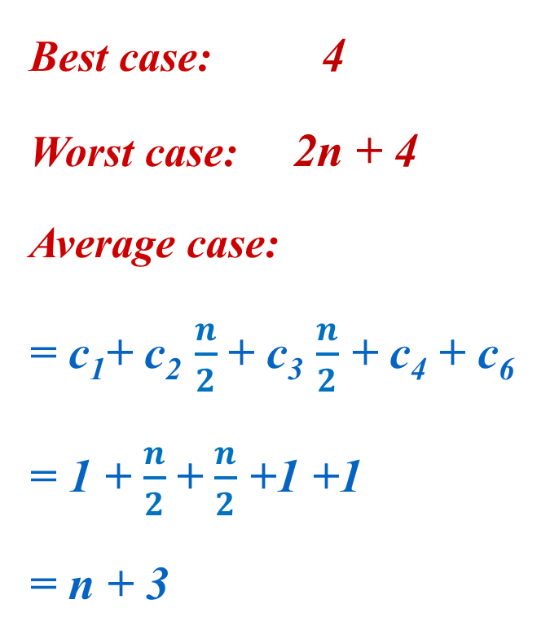

A Simple Example – Linear Search
LinearSearch(A, key)
1 i ← 1
2 while i ≤ n and A[i] != key
3 do i++
if i ≤ n
then return true
else return false
cost times
C₁ 1
C₂ x
C₃ x-1
C₄ 1
C₅ 1
C₆ 1
Running Time
Best case: 4
Worst case: 2n + 4
Average case:
= c₁+ c₂ $\frac{n}{2}$+ c₃ $\frac{n}{2}$ + c₄ + c₆
= 1 + $\frac{n}{2}$+ $\frac{n}{2}$ +1 +1
= n + 3
O(1)
O(n)
$$\frac{n}{2}$$
n + 3
O(n)
Notes:
If we assume that we search for a random item in the list, on an average, Statements 2 and 3 will be executed n/2 times. Running times of other statements are independent of input. Hence, average-case complexity is 1+ n/2+ n/2 + 1 + 1 = n+3

Slide 6
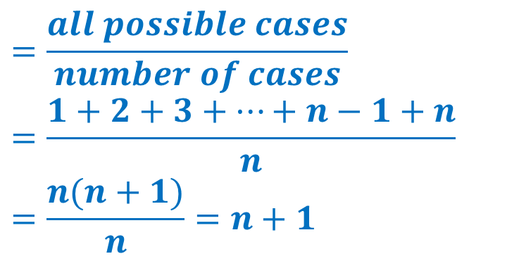
A Simple Example – Linear Search
7 | 2 | 8 | 4 | 3 | 6 | 9 | 15 | 24 | 1
1 | 2 | 3 | 4 | 5 | 6 | 7 | 8 | 9 | 10
Best case:
B(n) = O(1)
B(n) = Ω(1)
B(n) = Θ(1)
Worst case:
W(n) = O(n)
W(n) = Ω(n)
W(n) = Θ(n)
Average case:
A(n) = O(n)
A(n) = Ω(n)
A(n) = Θ(n)
$$=\frac{all possible cases}{number of cases}$$
$$=\frac{1+2+3+…+n−1+n}{n}$$
$$=\frac{n(n+1)}{n}=n+1$$

Slide 7
A Simple Example – Binary Search
10
20
10
30
40
Best case:
B(n) = O(1)
h
30
5
15
25
40
25
Worst case:
Height of tree
20
h
log n
W(n) = h
15
n
10
min(W(n)) = log n
5
max(W(n)) = n
10
15
15

Slide 8
Space-Time Tradeoff
Sometimes the choice of a data structure involves a space-time tradeoff.
Increasing the amount of space for storing the data, we may be able to reduce the time needed for processing data or vice-versa.
Either in less time and by using more space, or
In very little space by spending a longer amount of time.

Slide 9
Types of tradeoff
Lookup tables vs. recalculation
Compressed vs. uncompressed
Data Re-rendering vs. stored images
Smaller code vs. loop unrolling

Slide 10
Types of tradeoff
Lookup tables vs. recalculation
An algorithm involving a lookup table:
an implementation can include the entire table, which reduces computing time, but increases the amount of memory needed, or it can compute table entries as needed, increasing computing time, but reducing memory requirements.

Slide 11
Types of tradeoff
Compressed vs. uncompressed
If data is stored uncompressed, it takes more space but access takes less time than if the data were stored compressed (since compressing the data reduces the amount of space it takes, but it takes time to run the decompression algorithm).
There are also rare instances where it is possible to directly work with compressed data, such as in the case of compressed bitmap indices, where it is faster to work with compression than without compression.

Slide 12
Types of tradeoff
Data Re-rendering vs. stored images
Storing only the SVG source of a vector image and rendering it as a bitmap image every time the page is requested would be trading time for space; more time used, but less space.
Rendering the image when the page is changed and storing the rendered images would be trading space for time; more space used, but less time. This technique is more generally known as caching.

Slide 13
Types of tradeoff
Smaller code vs. loop unrolling
Larger code size can be traded for higher program speed when applying loop unrolling.
This technique makes the code longer for each iteration of a loop, but saves the computation time required for jumping back to the beginning of the loop at the end of each iteration.

